Slide 1
Create Source SYSTEM
Milind Parab
Date: July 16, 2017

Slide 2
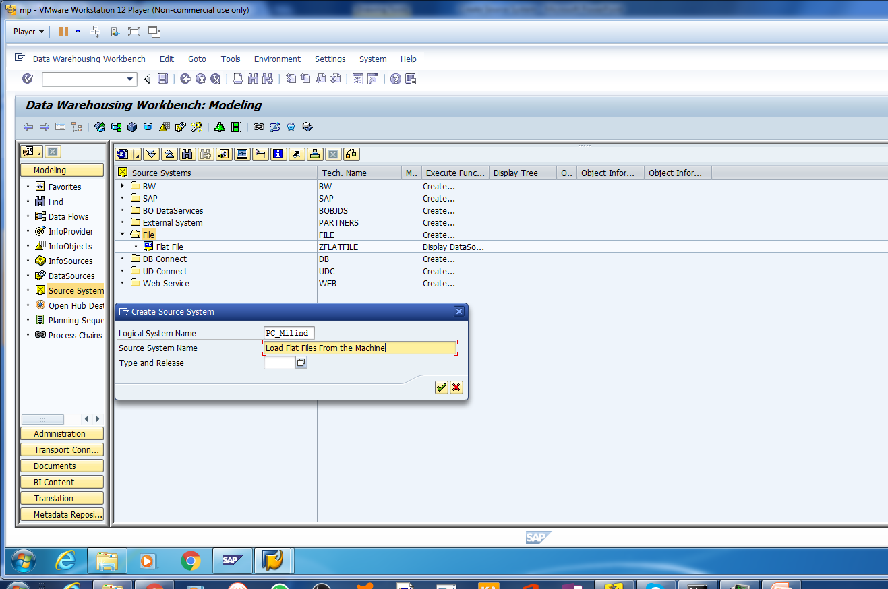
Right Click on The File inside Source System and Create a new Source System.

Slide 3
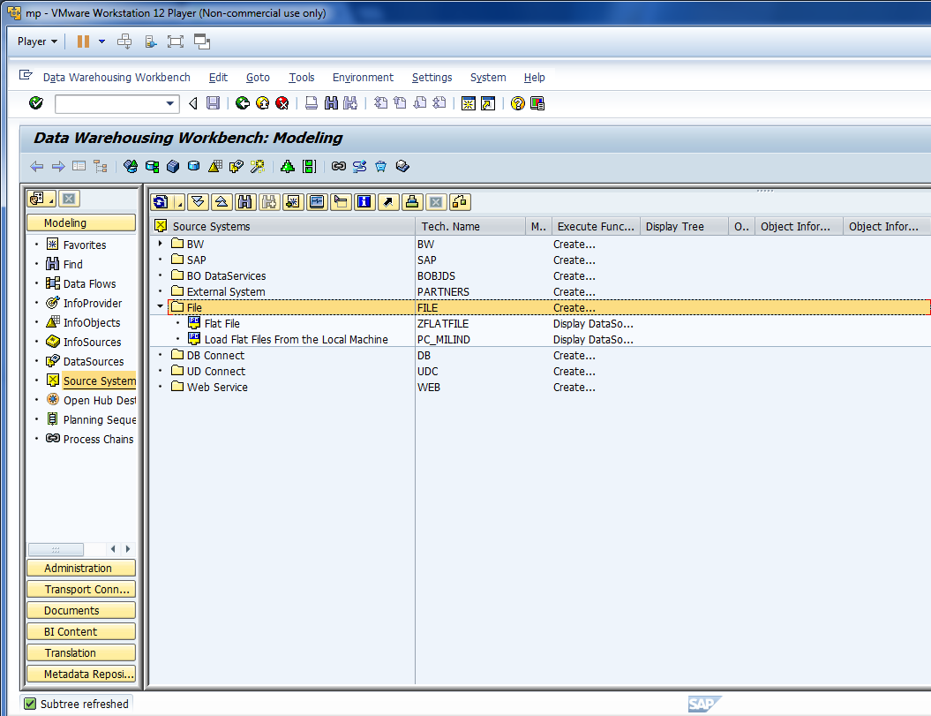
Cont. eg. PC_MILIND

Slide 4
Create Info-area and Enter the data manually
Milind Parab

Slide 5
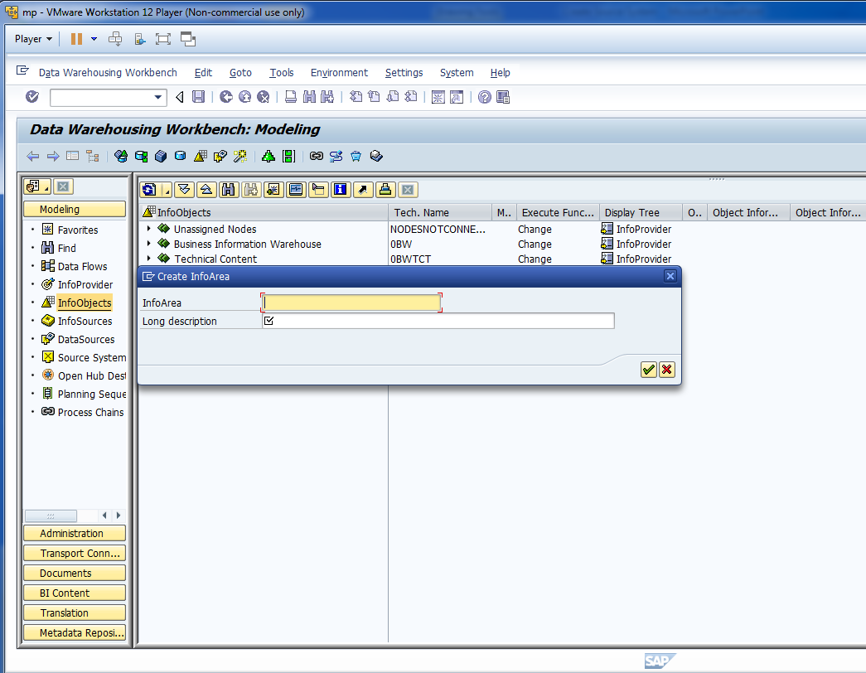
Create Info-Area : IA_Demo1

Slide 6
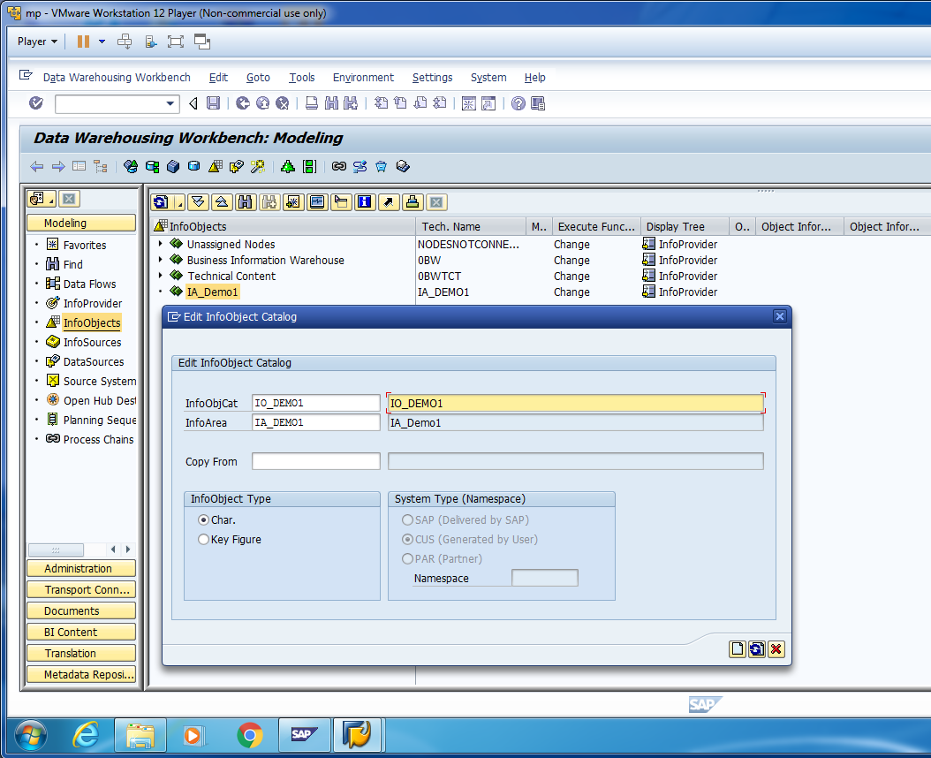
Right Click on Info-Area and create an Info-Object Catalog.

Slide 7
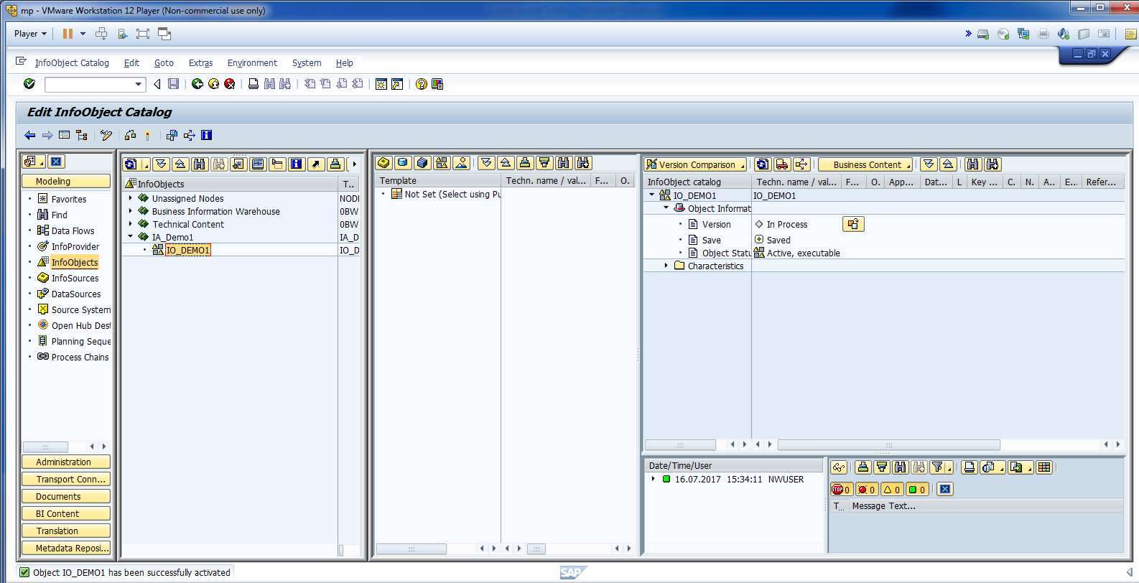
Activate Info-Object Catalog.

Slide 8
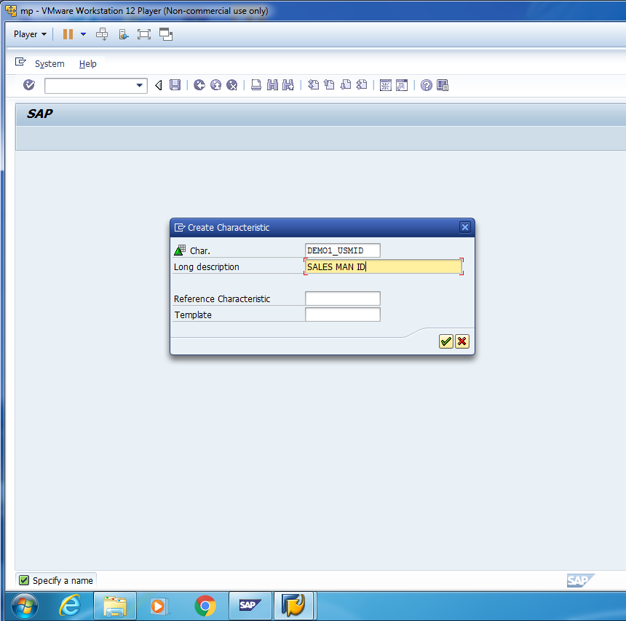
Right Click on Info-Object Catalog and Create Info-Object.

Slide 9
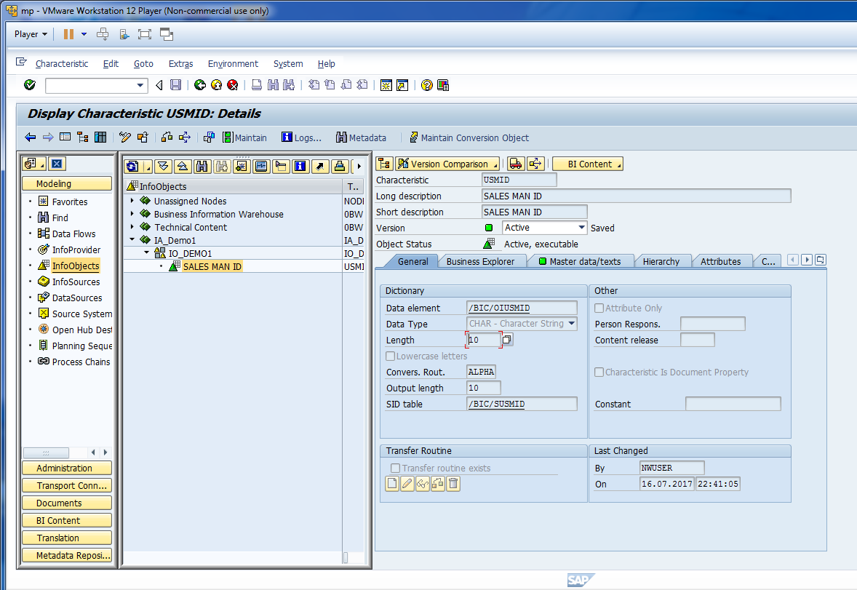
Once you create the Object, activate the object.

Slide 10
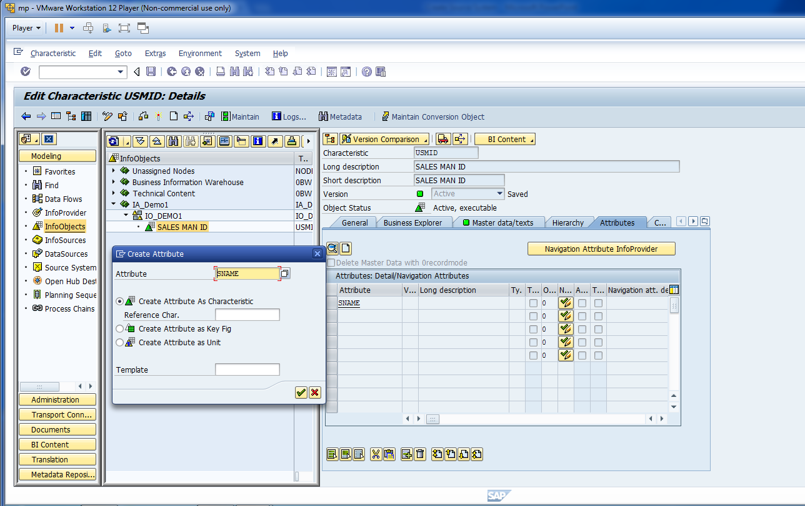
Create Char. Attributes.

Slide 11
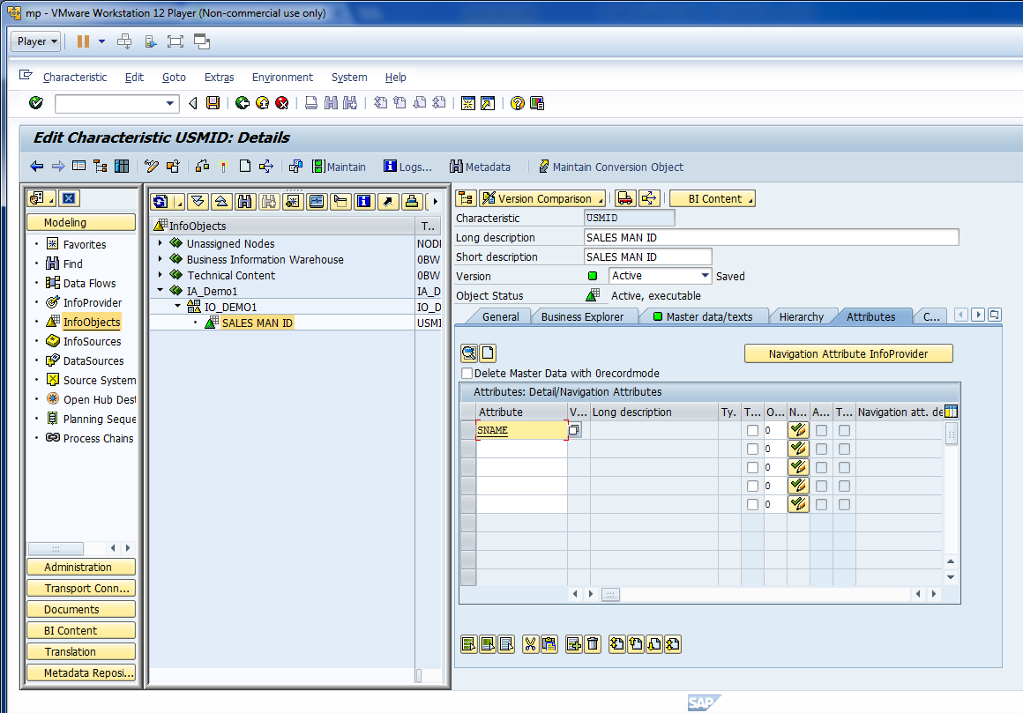
Now, create attributes for Sales Man.

Slide 12
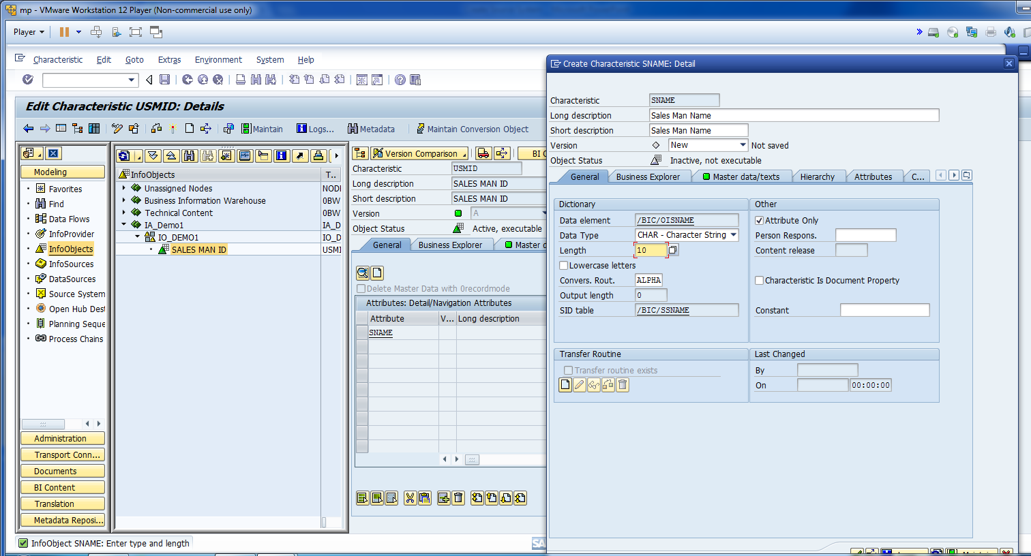
Fill out the information for Attributes.

Slide 13
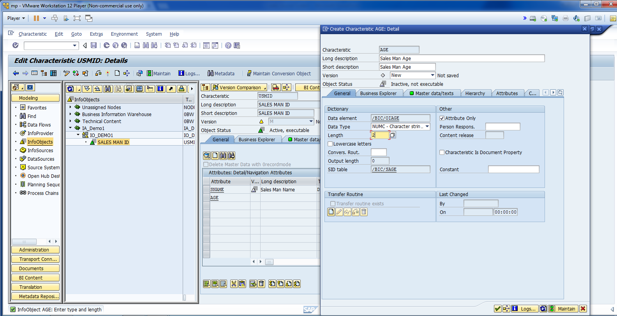
Create Attribute Age.

Slide 14
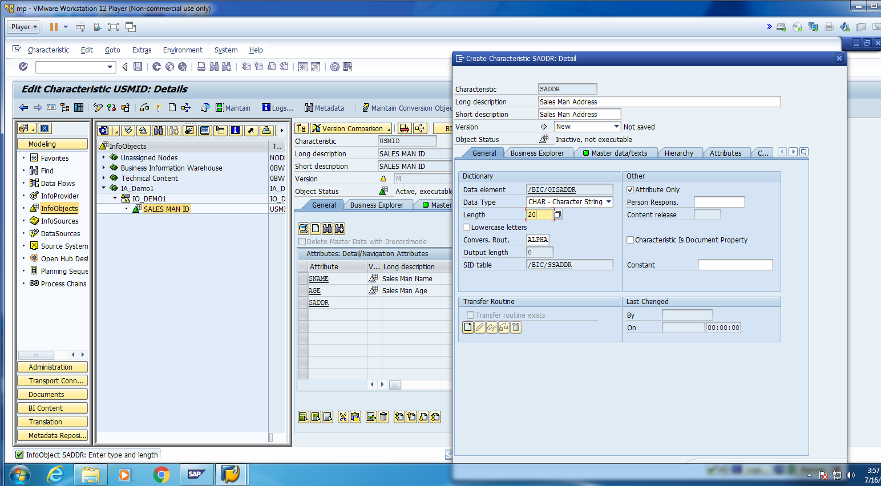
Create Attribute Address.

Slide 15
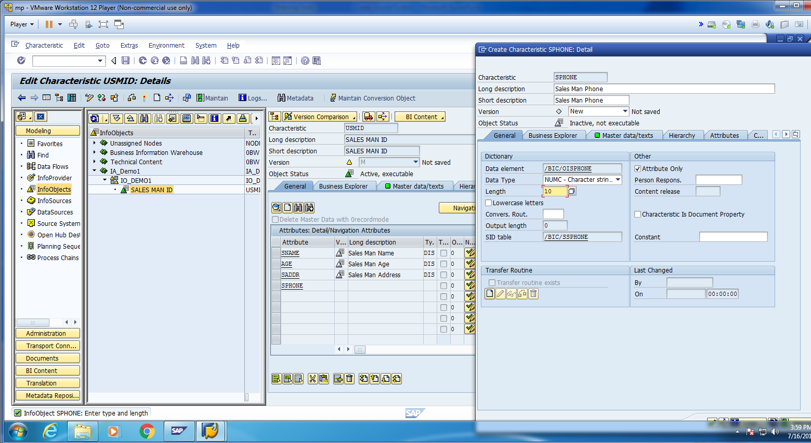
Create Attribute Phone.

Slide 16
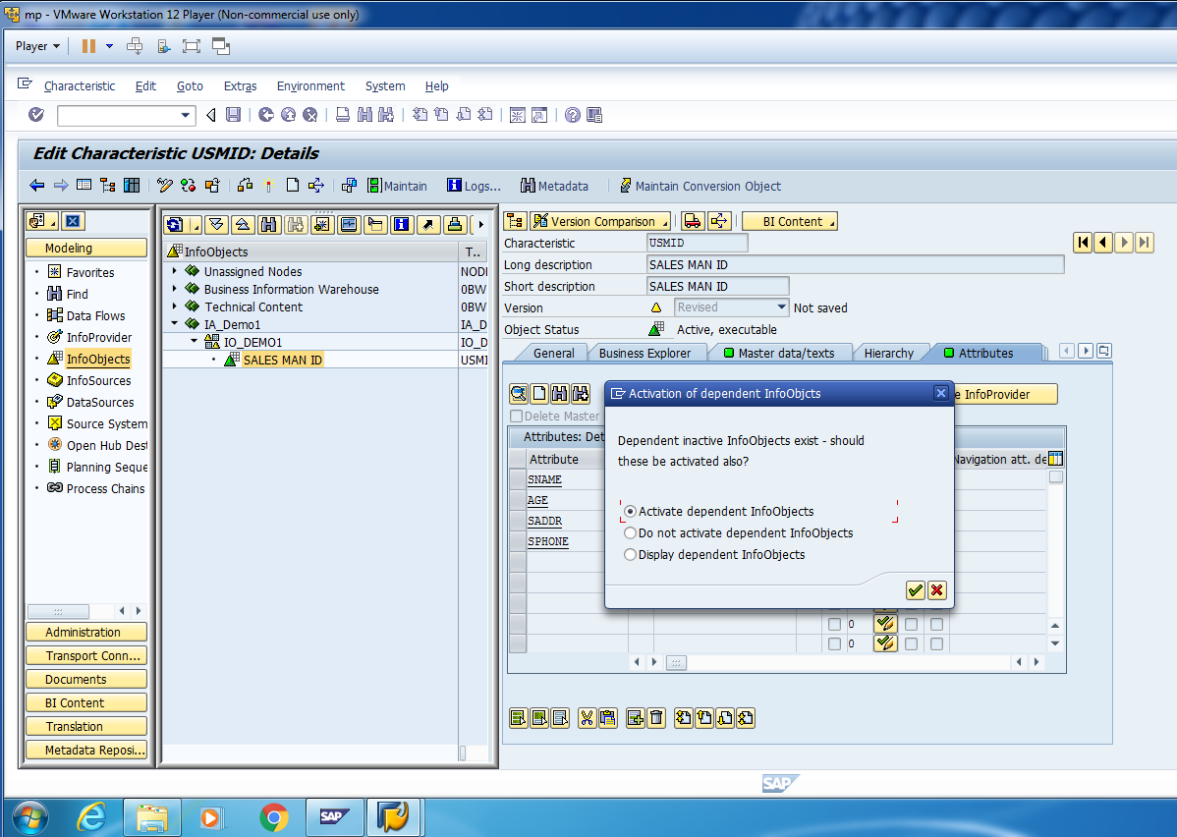
Activate as dependent Info-Object.

Slide 17
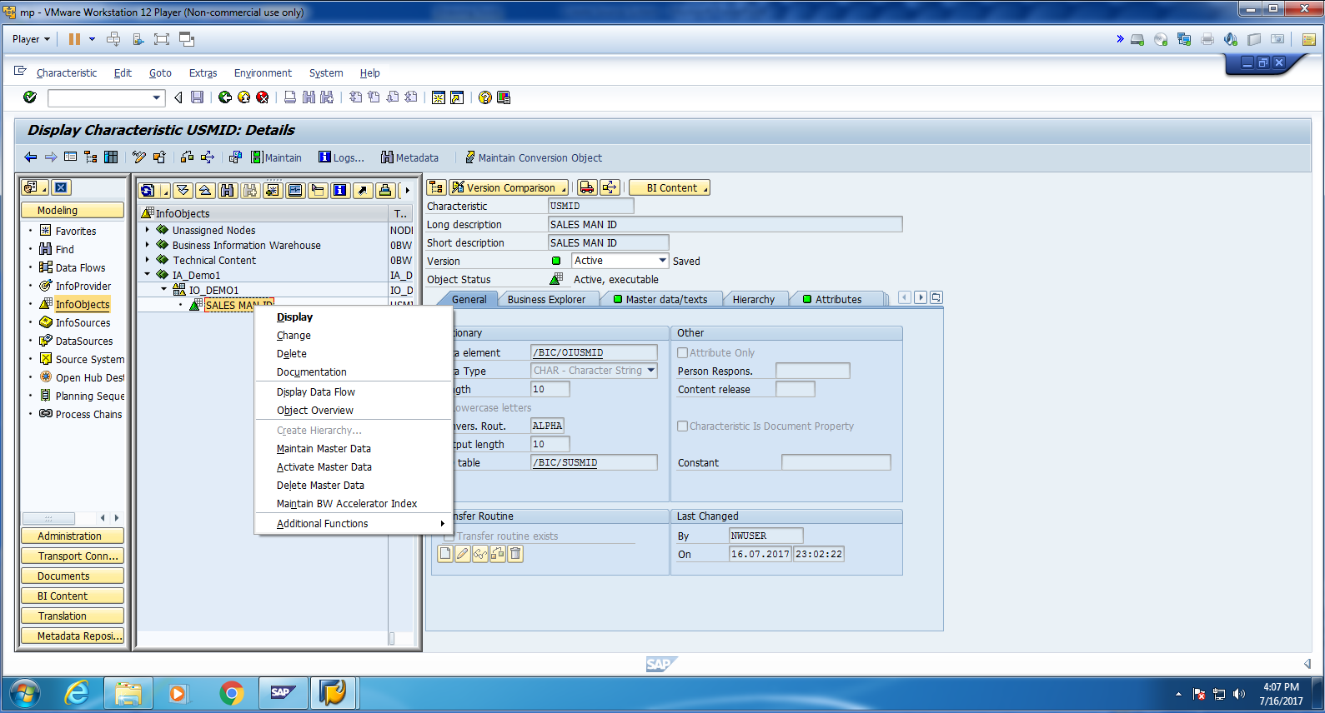
Go to Maintain Master Data.

Slide 18
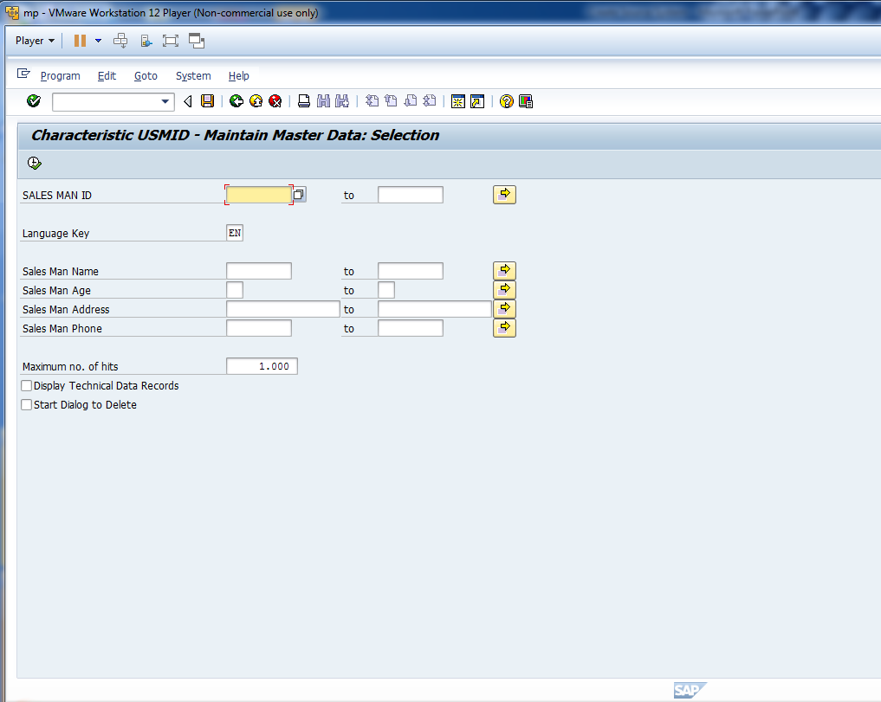
Cont.

Slide 19
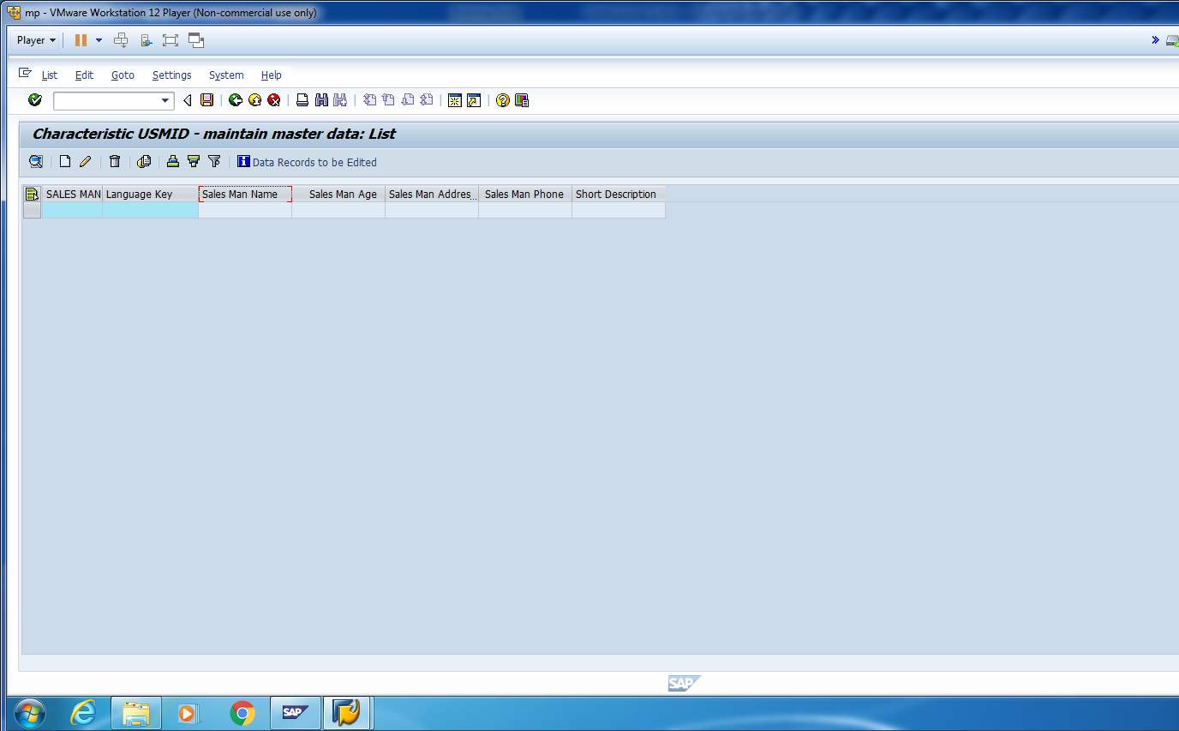
It is empty.

Slide 20
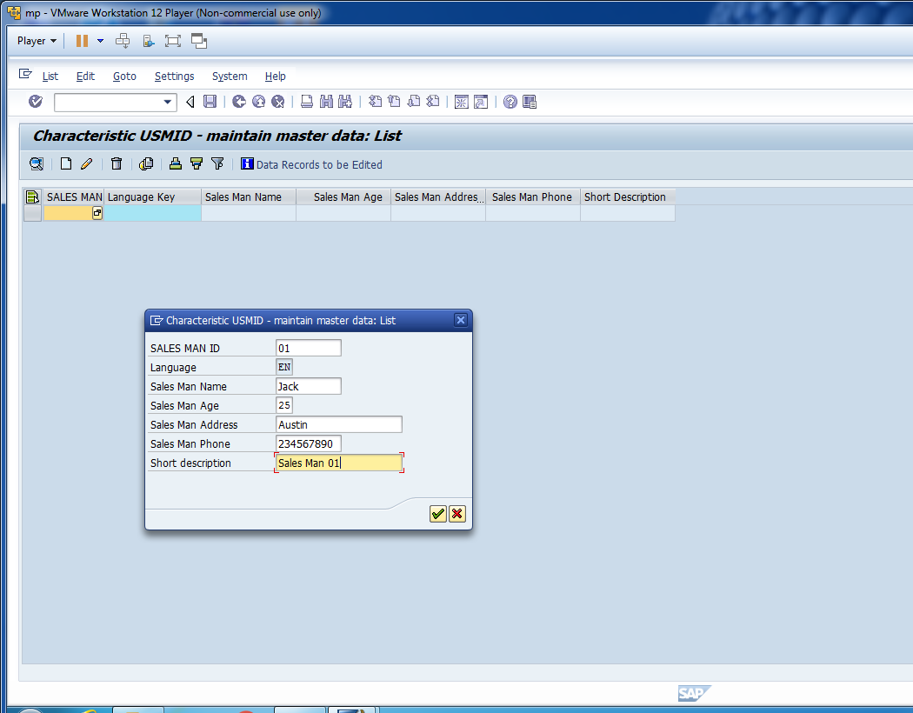
Click on Create and Enter the details.

Slide 21
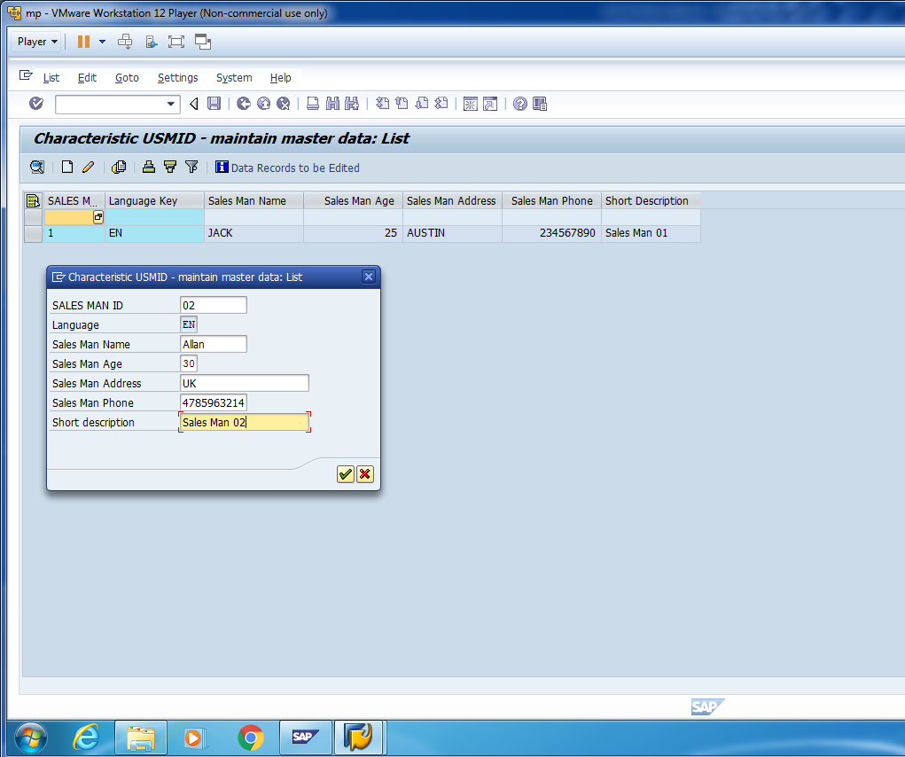
Create another record.

Slide 22
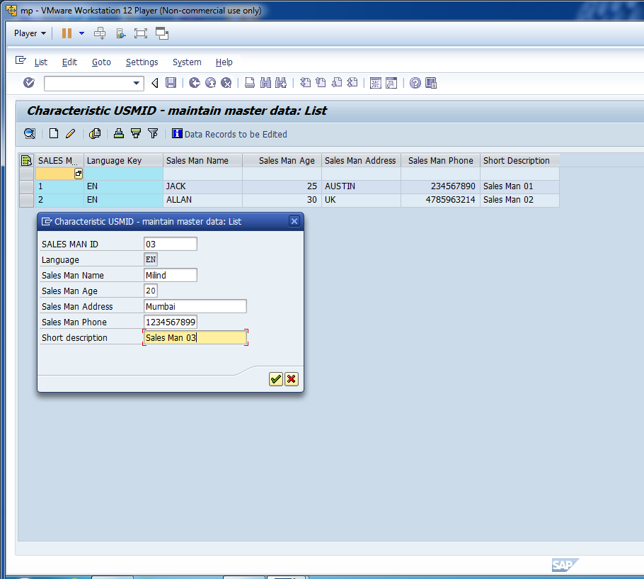
Create one more record and save data.

Slide 23
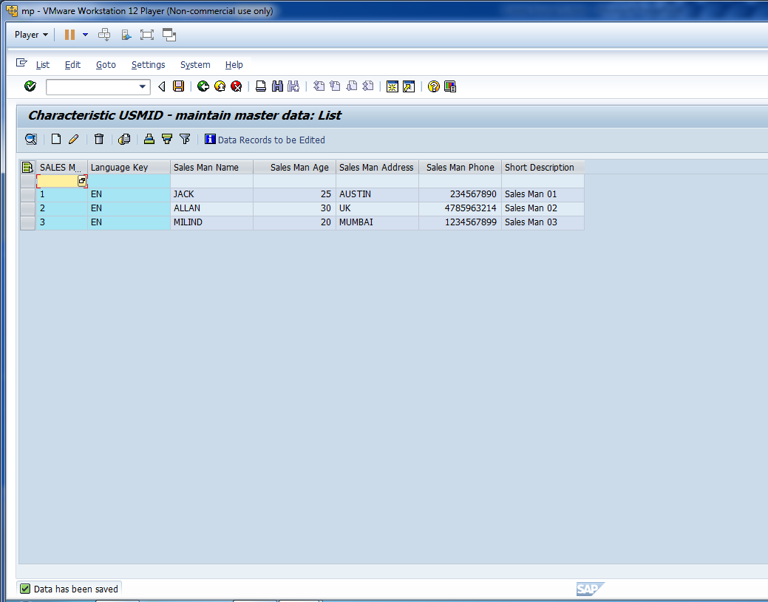
Save the data and go to T-code“SE11”.

Slide 24
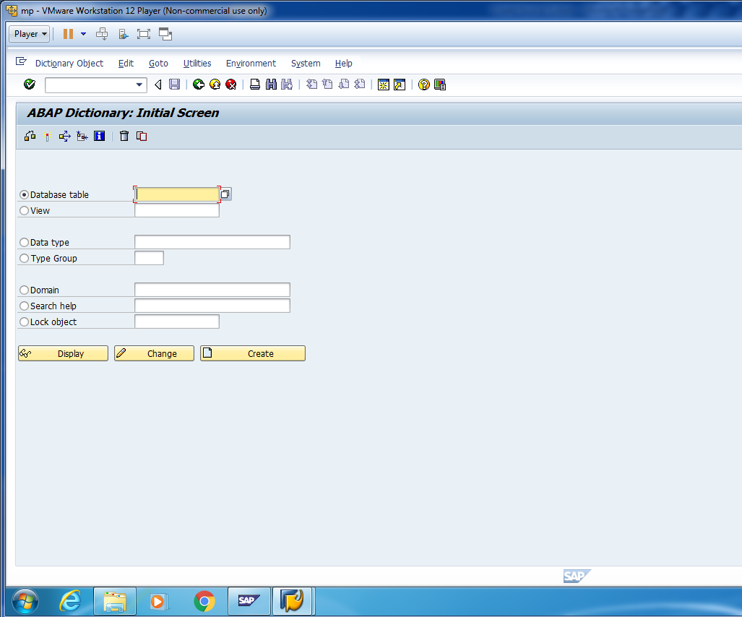
Cont.

Slide 25
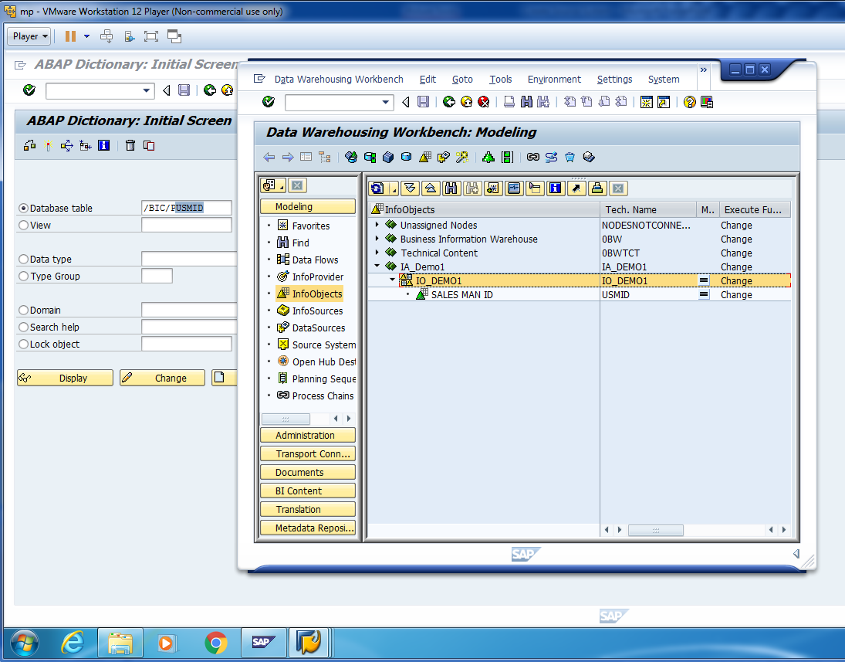
Check the data in P- Table.

Slide 26
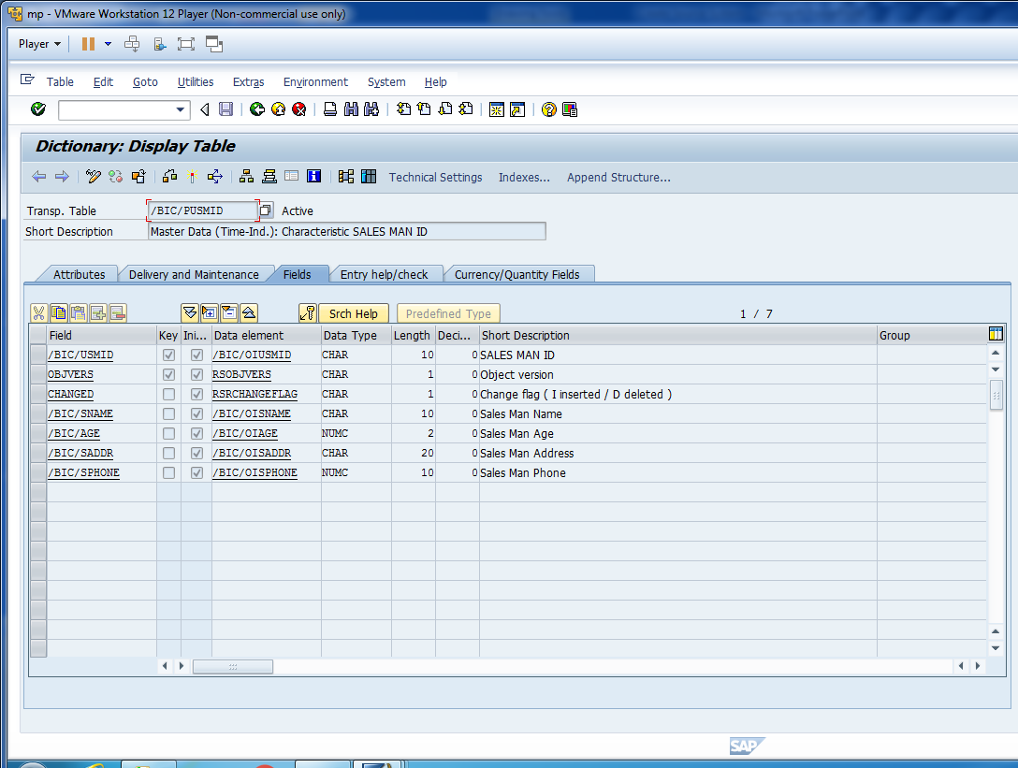
Cont.

Slide 27
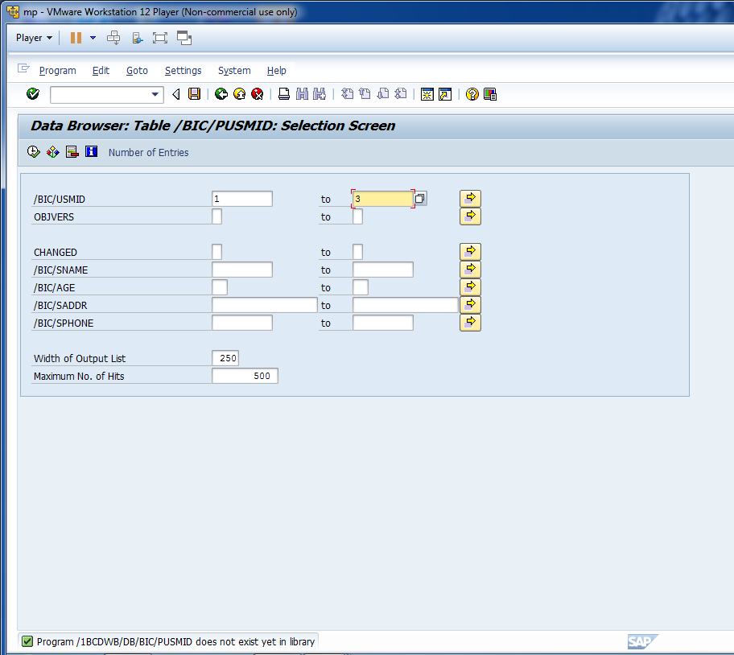
Let’s say we want to see first 3 records.

Slide 28
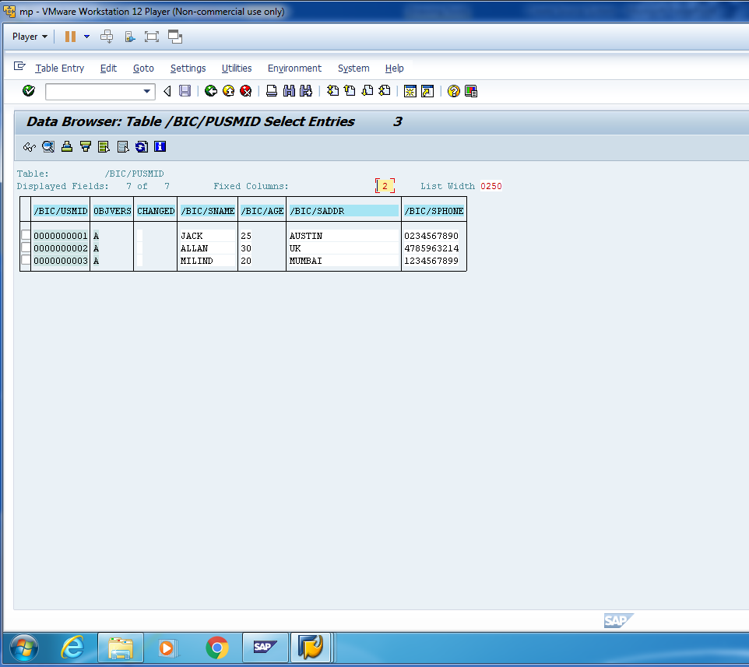
Content in P-Table.

Slide 29
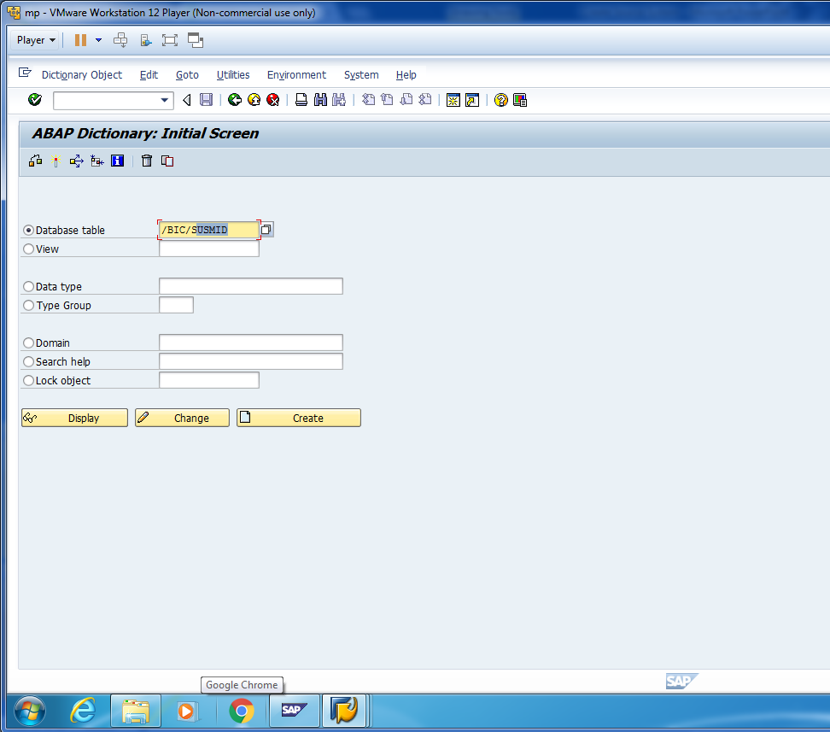
Similarly, we can check the data in S-Table.

Slide 30
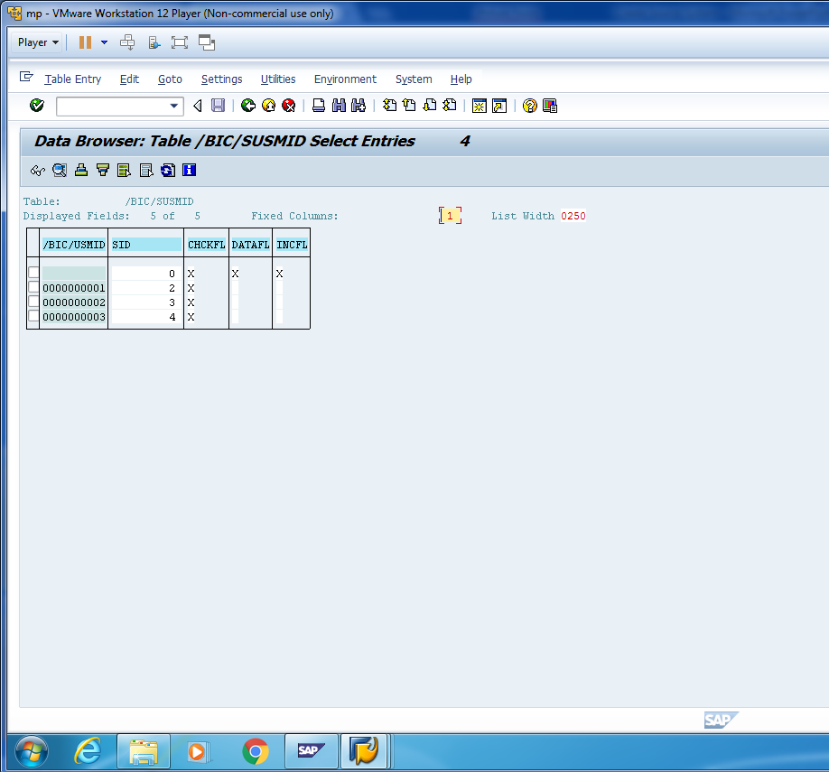
Content in S-Table.

Slide 31
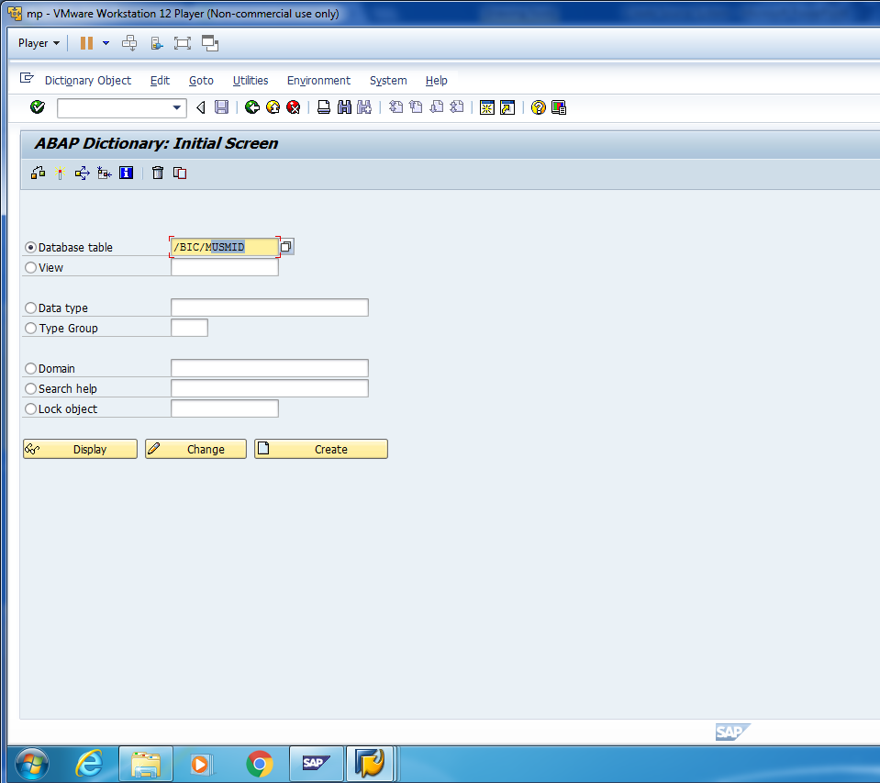
Similarly, we can check the data in M-View.

Slide 32
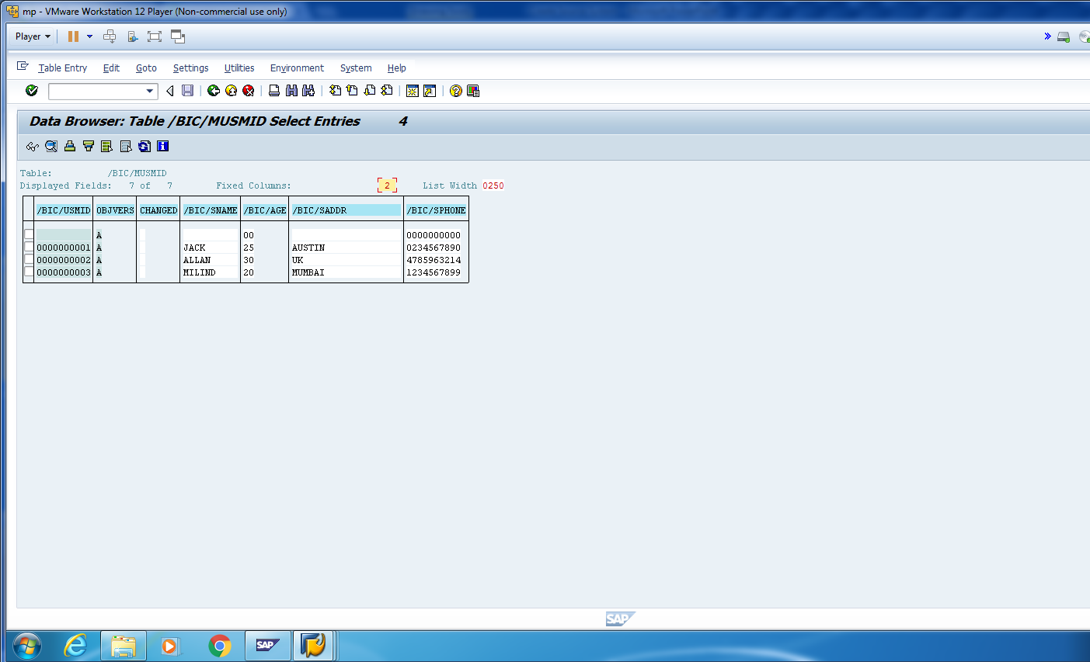
Content in M-View.

Slide 33
Load data in bw from flat file
Milind Parab

Slide 34
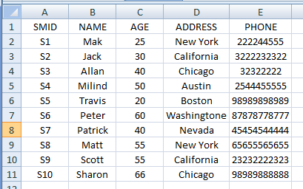
Data In Flat File.

Slide 35
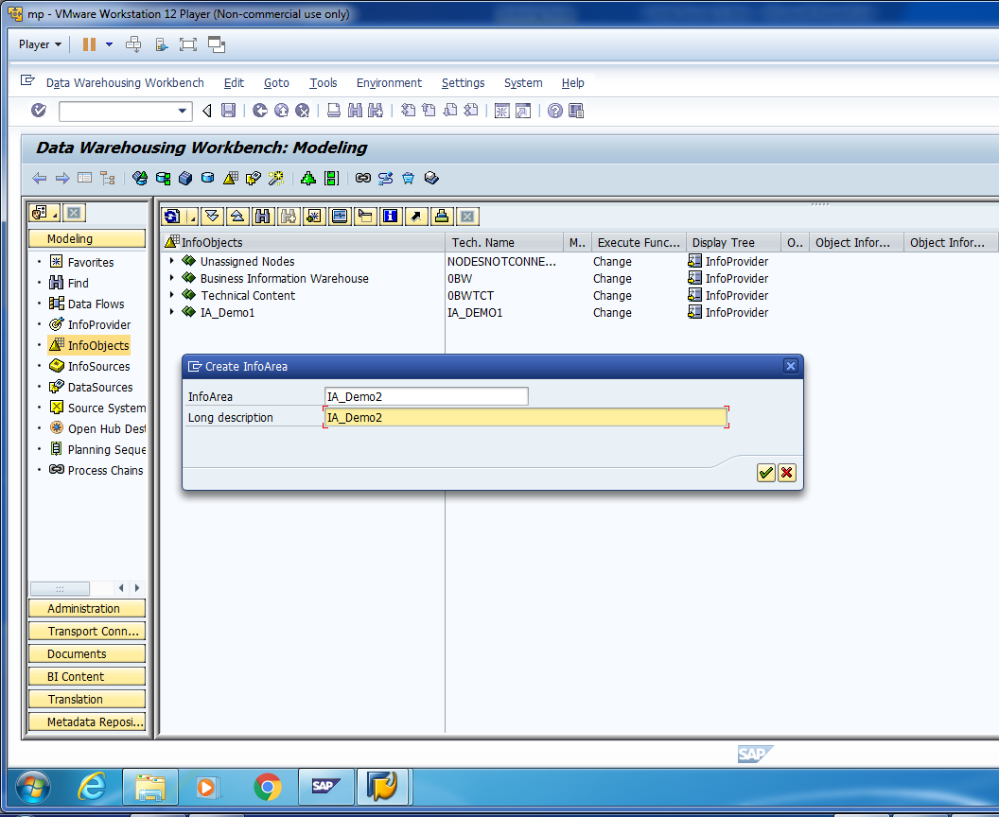
Create Info-Area for Demo-2.

Slide 36
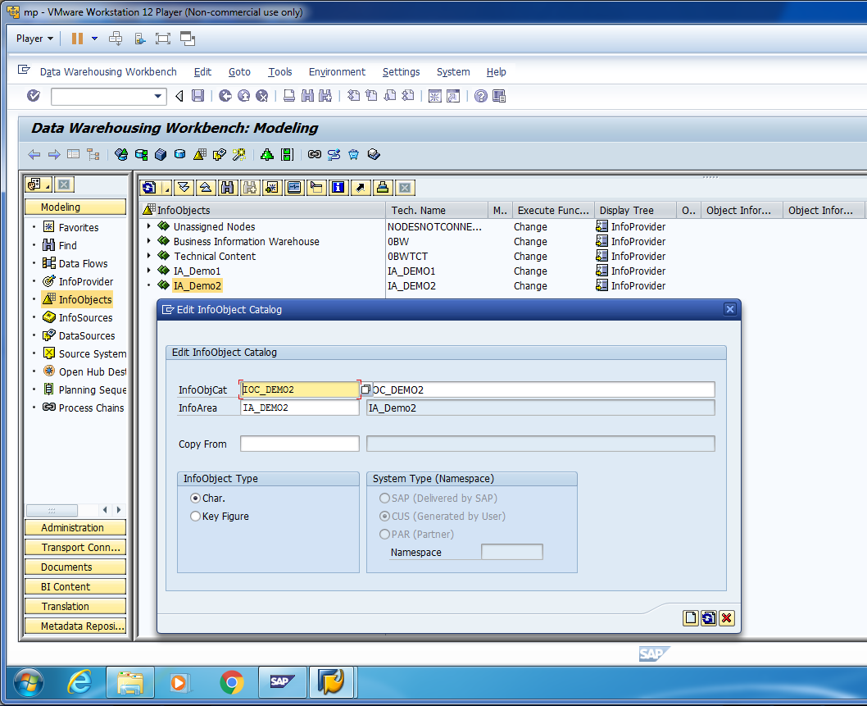
Create Info-Object Catalog for Demo-2.

Slide 37
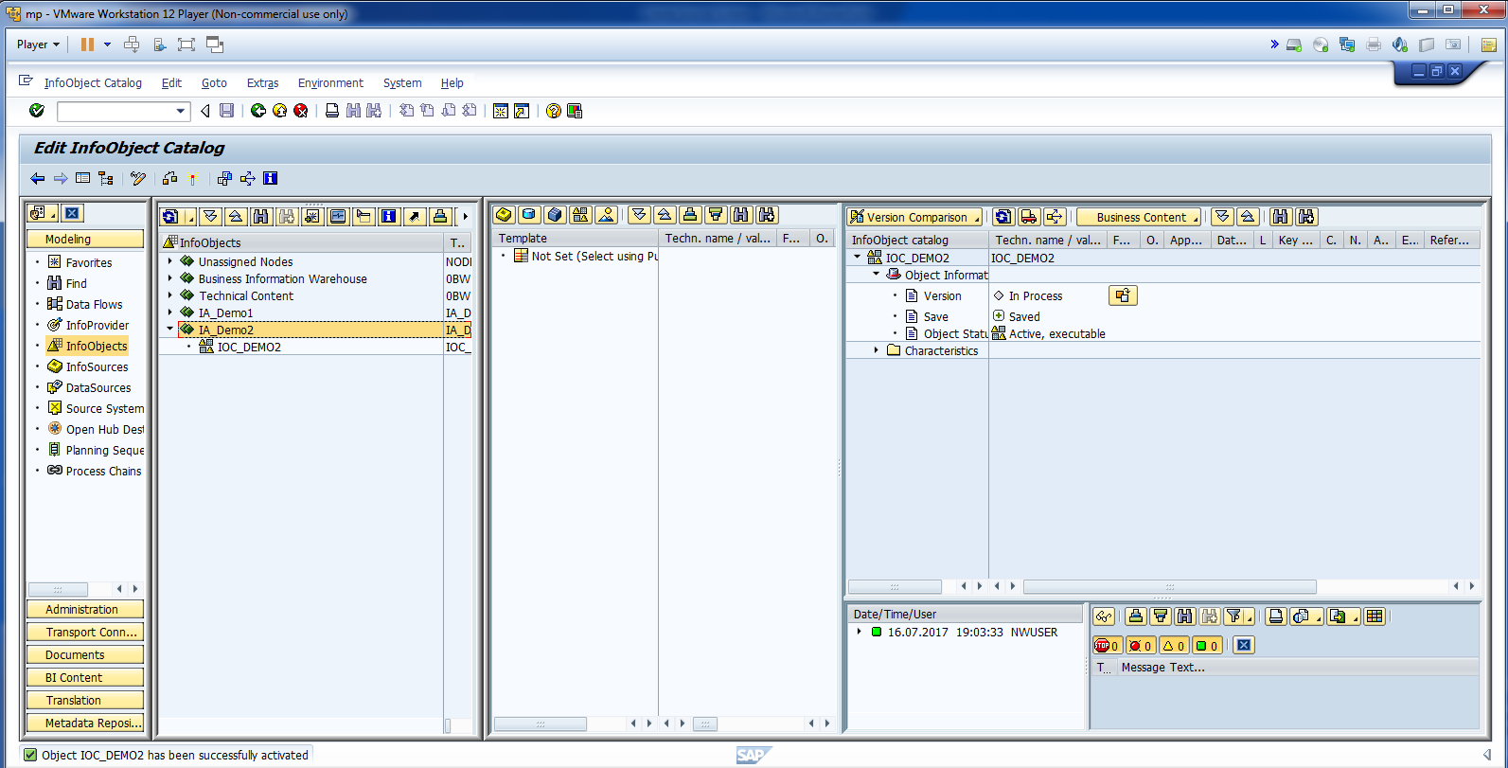
Activate Info-Object Catalog.

Slide 38
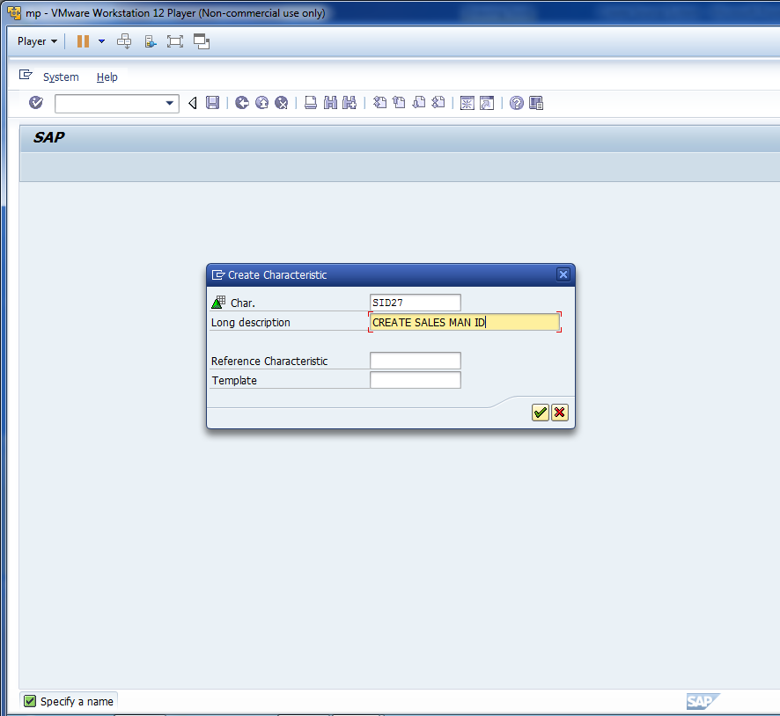
Create Info-Object.

Slide 39
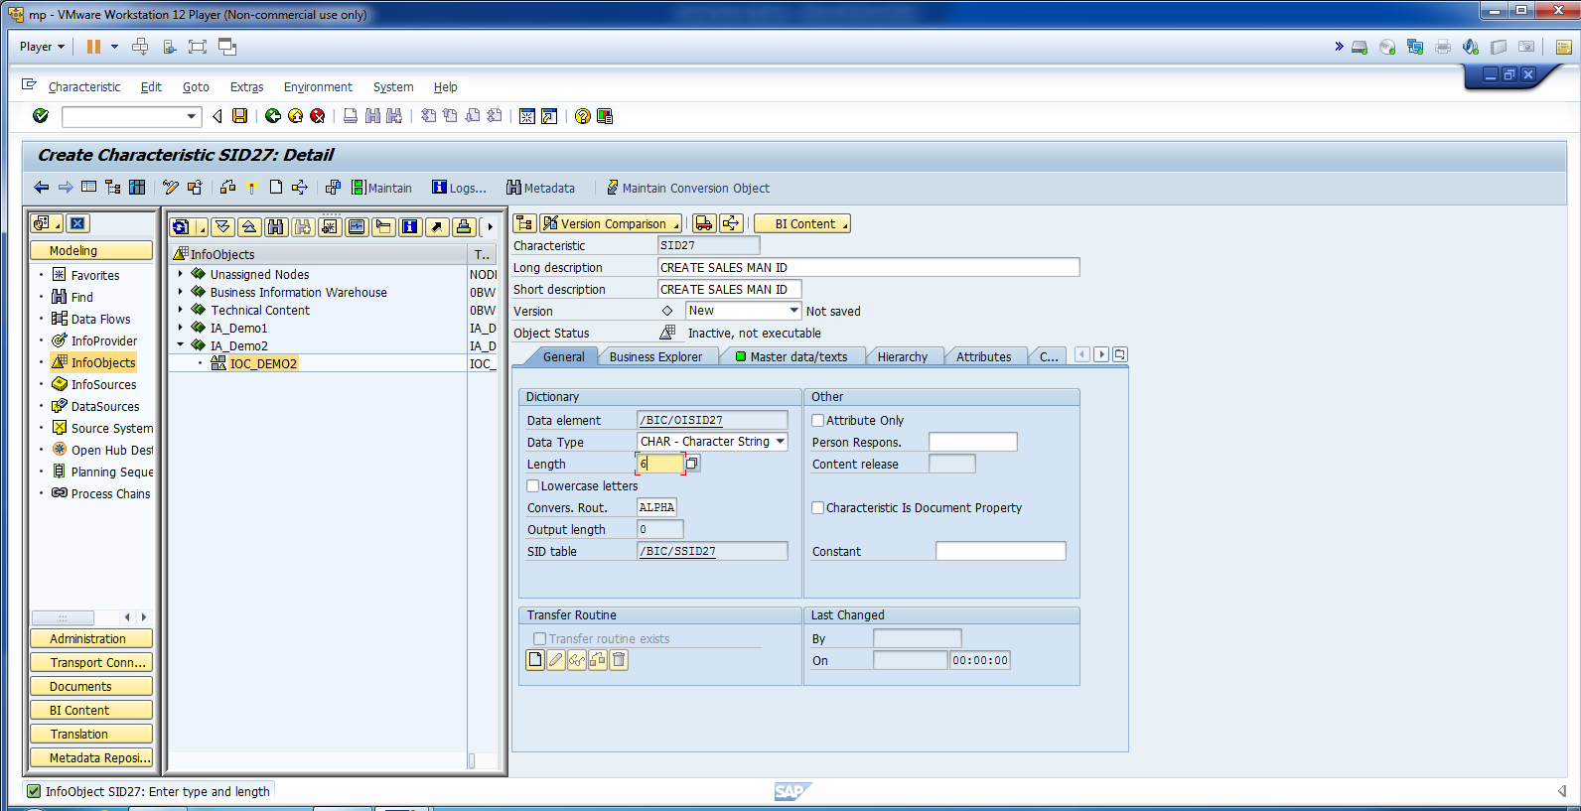
Update Information for SID27.

Slide 40
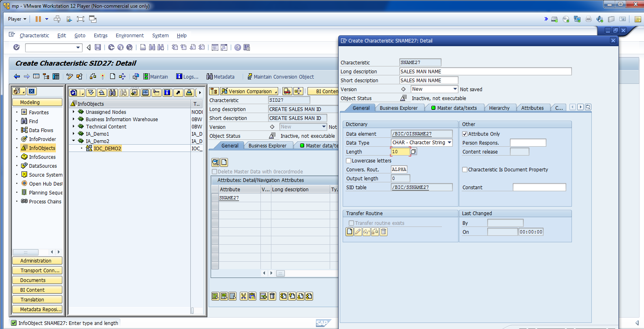
Now, create Name, Age, Address, and Phone Number Attributes.

Slide 41
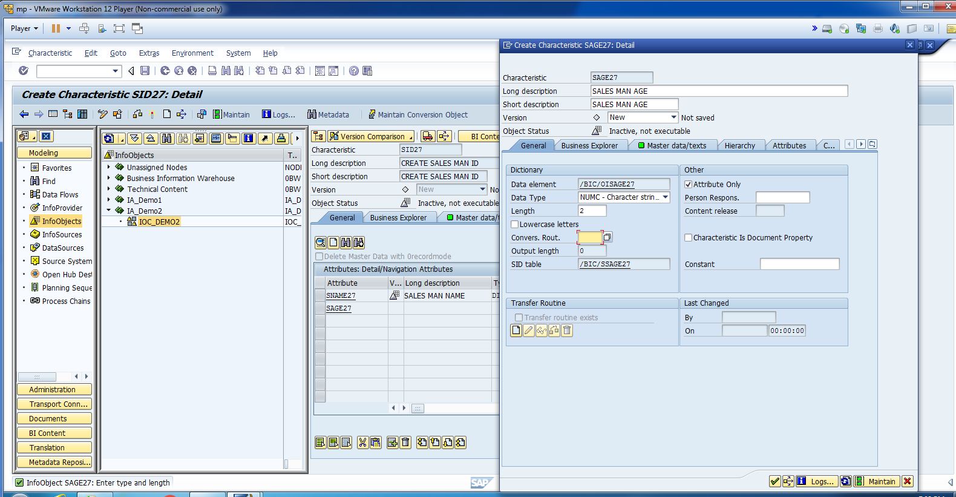
Age Attribute.

Slide 42
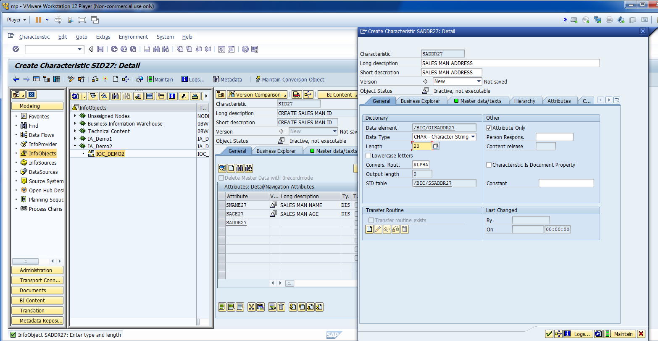
Address Attribute.

Slide 43
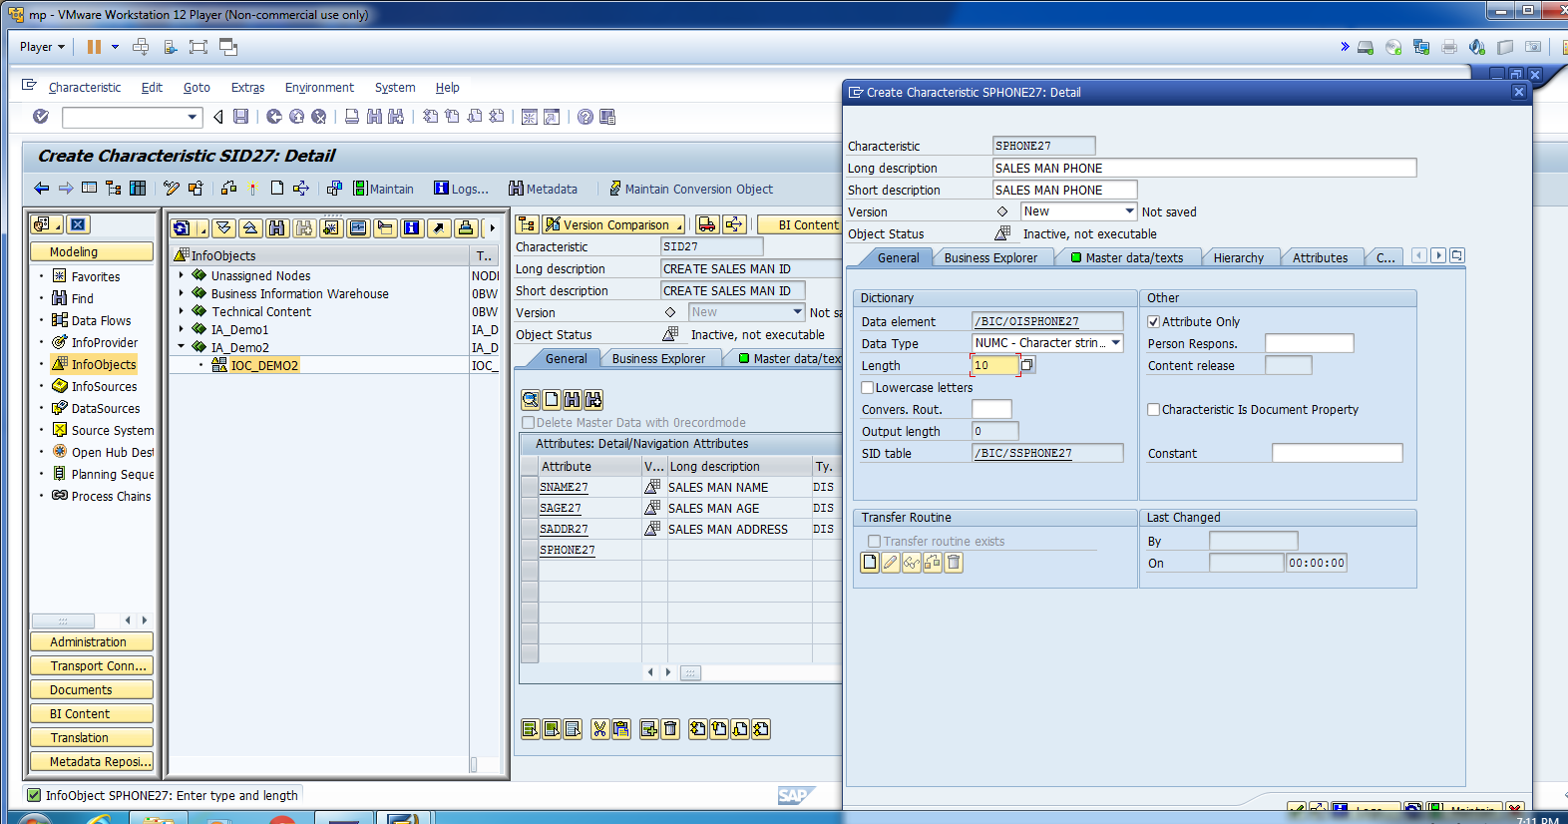
Phone Attribute.

Slide 44
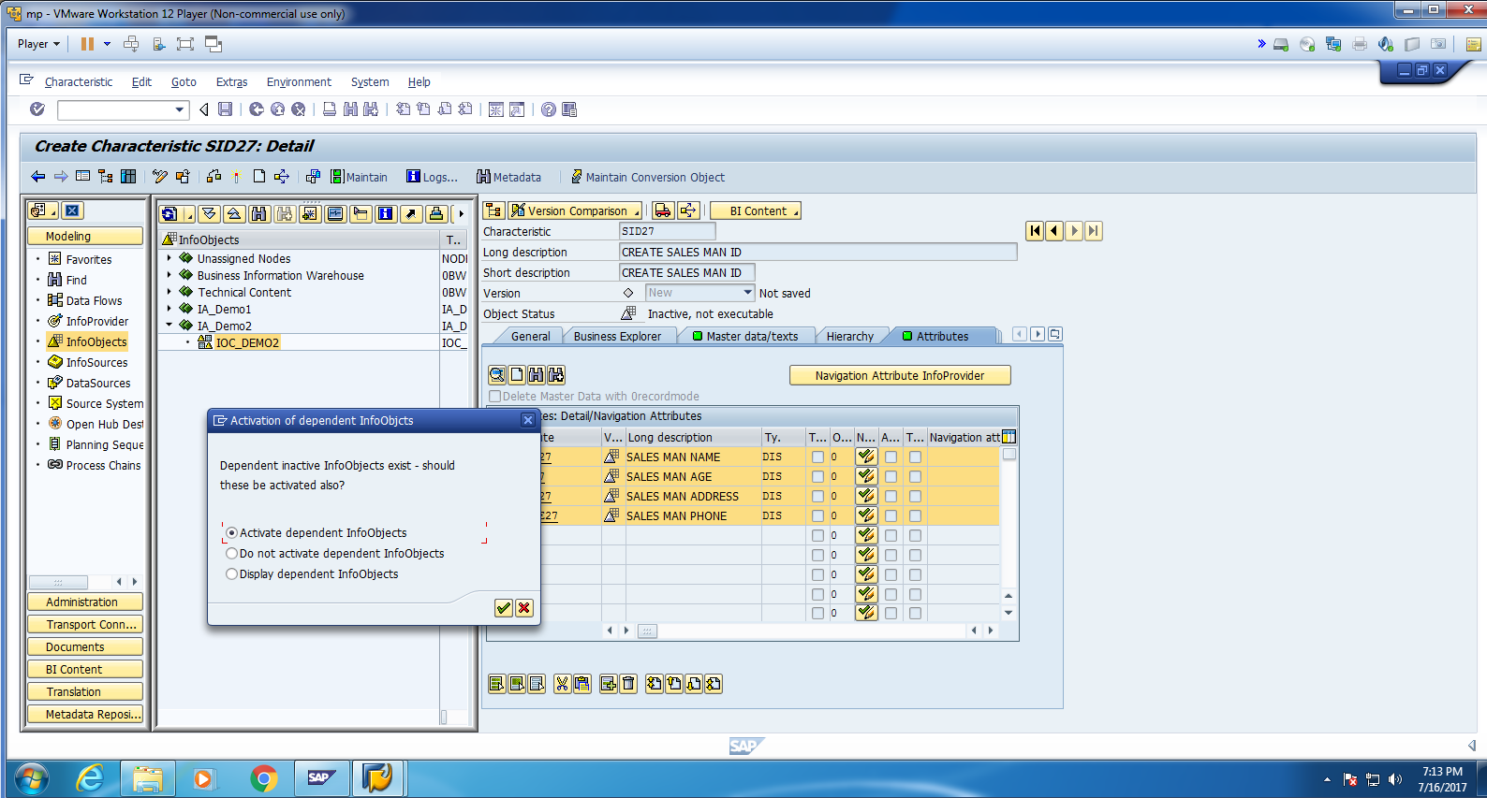
Activate Info Objects.

Slide 45
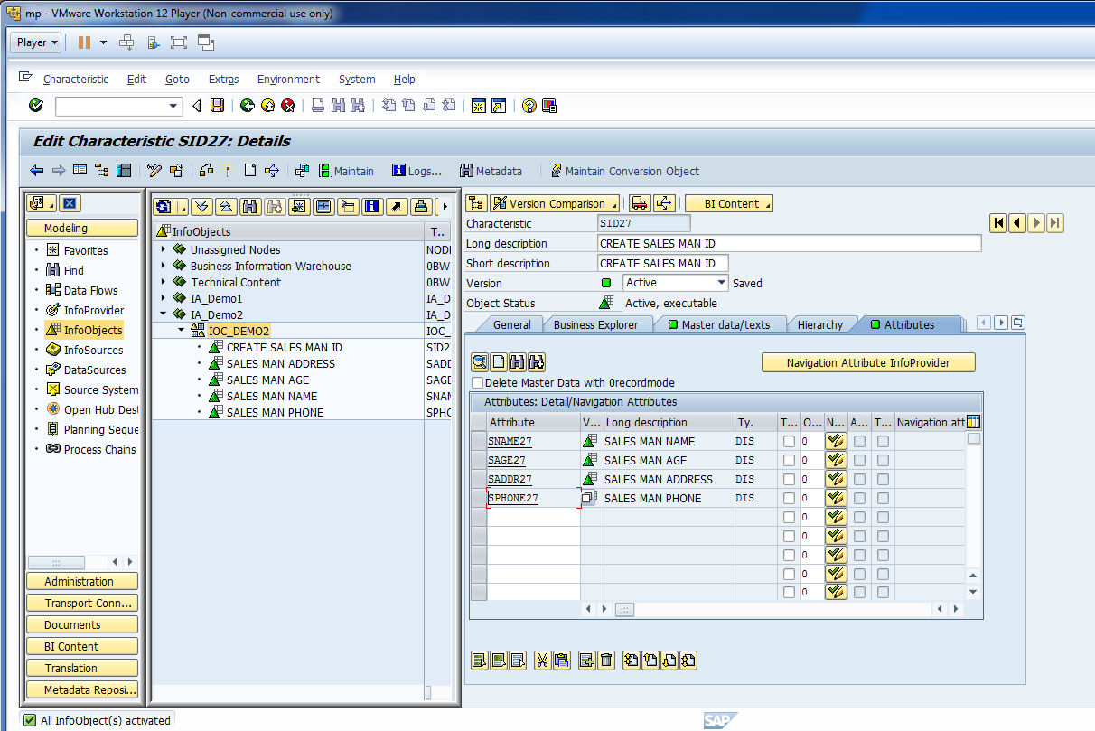
You can see below, all objects are activated.

Slide 46
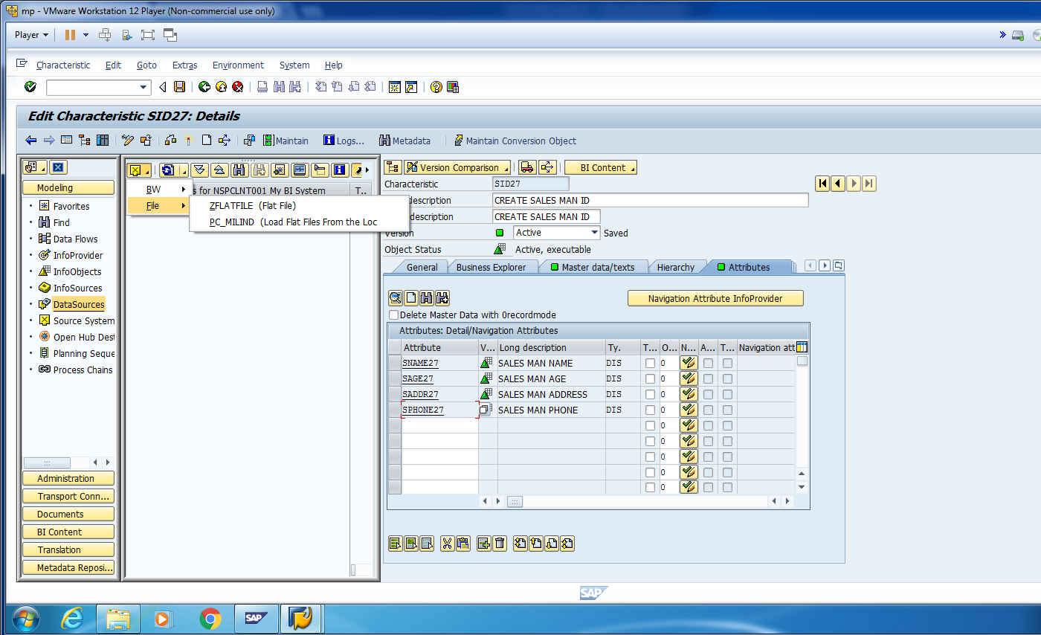
Now Click on File and Make sure that correct data source is selected. Eg. PC_MILIND in this example.

Slide 47
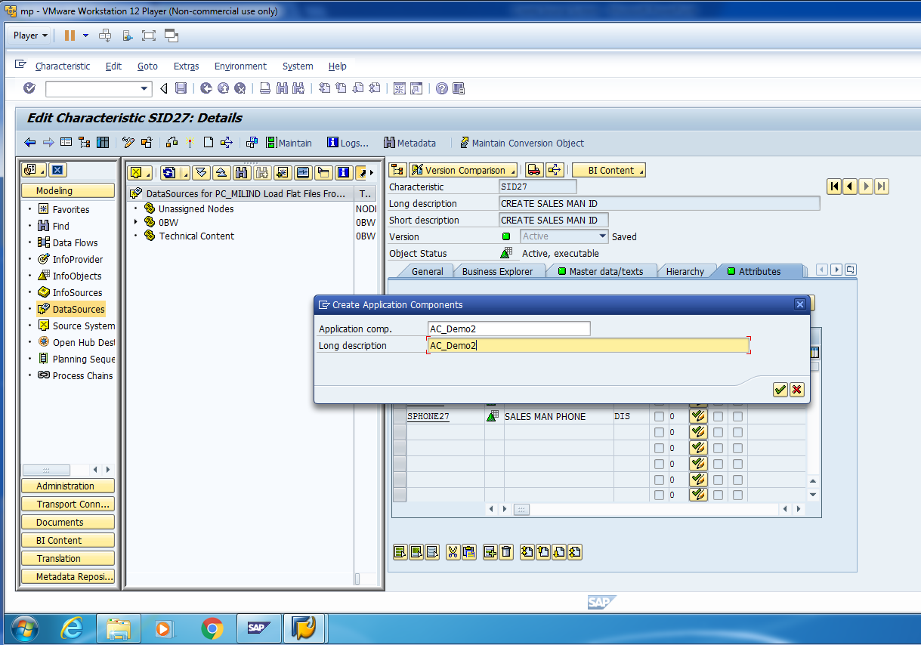
Create Application Component by Right Click on Data-Source Status Bar.

Slide 48
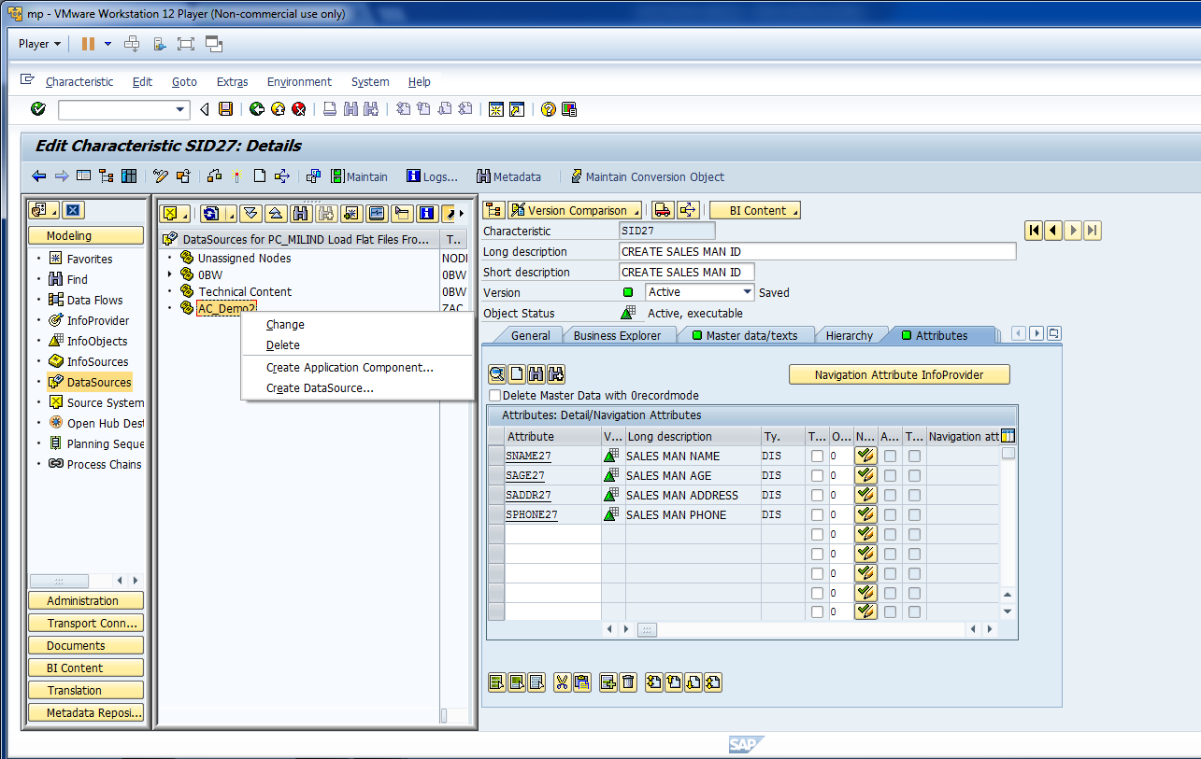
Now, create a Data Source.

Slide 49
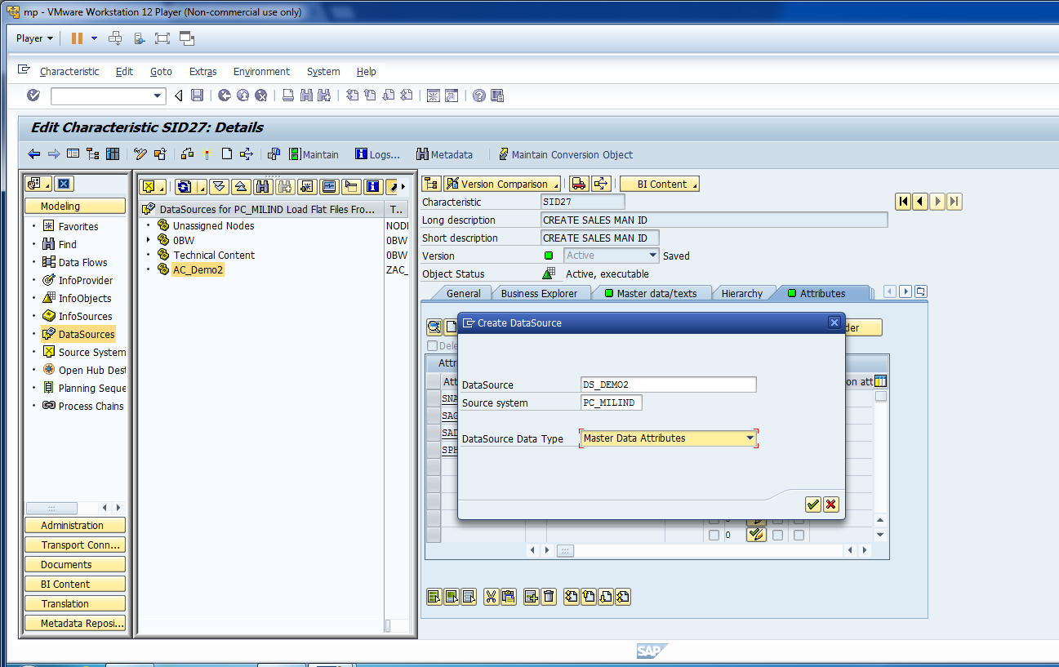
Cont.

Slide 50
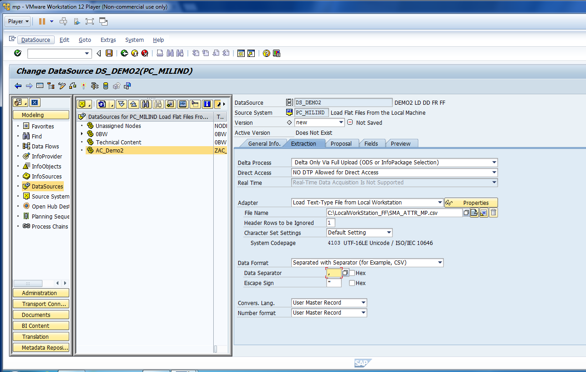
Update Extraction Information.

Slide 51
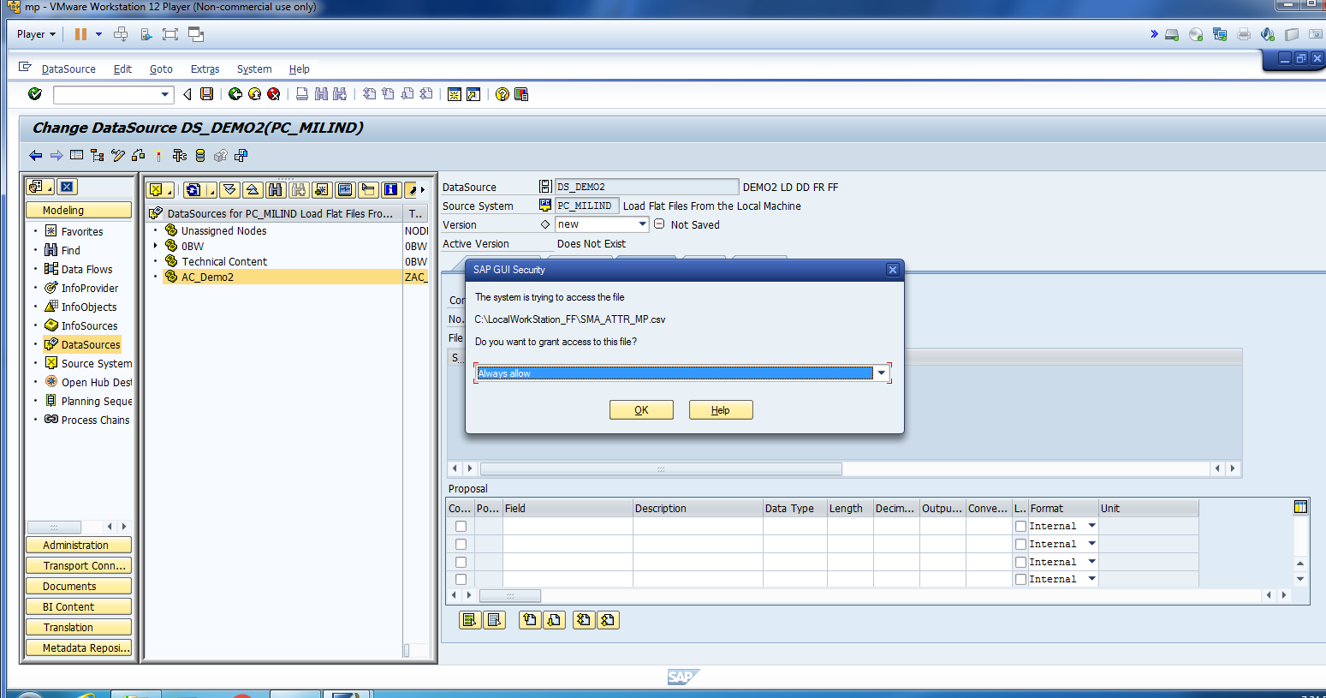
Allow BW to Access The Location.

Slide 52
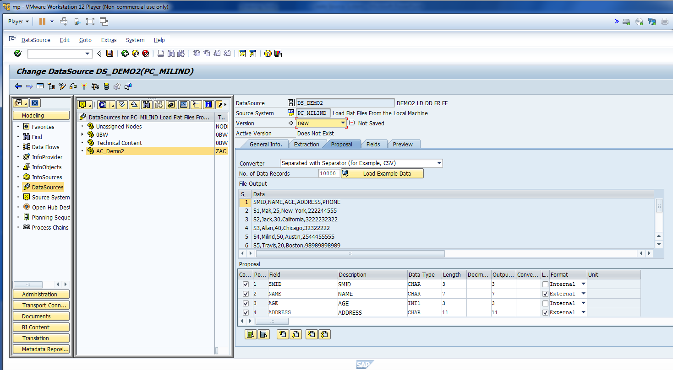
Check The Proposal Data.

Slide 53
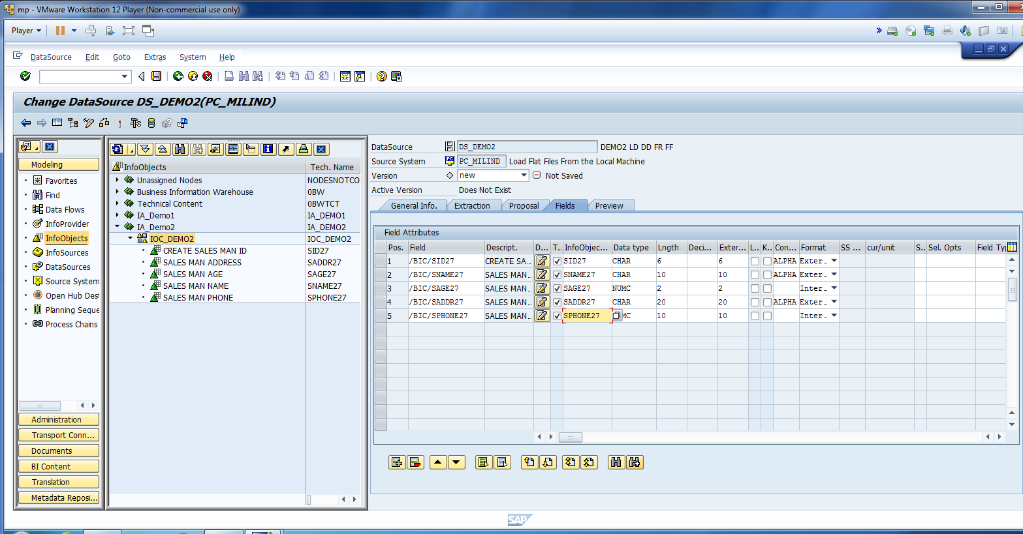
Map Excel Fields with Info Objects.

Slide 54

Activate Data Source to See Preview Data.

Slide 55

You should see load preview.

Slide 56

Create Data Target. Select Insert Char. as Info-Provider.

Slide 57

Enter Info Object Tech Name.

Slide 58

Now, Create Transformation.

Slide 59

Enter The Information for Transformation.

Slide 60

As we already mapped the field you should see all fields has been mapped

Slide 61

Activate Transformation.

Slide 62

You can click on display data flow.

Slide 63

You can see the data flow

Slide 64

Refresh. Click on data source and create info package.

Slide 65

Enter desc and save.

Slide 66

For training purpose, start data loading immediately.

Slide 67

Click on monitor to check the status of the data.

Slide 68

Click on PSA Maintenance.

Slide 69

Check the same data has been loaded to PSA.

Slide 70

Now, Create Data Transfer Process.

Slide 71

Select Extraction Mode to Full.

Slide 72

Activate DTP.

Slide 73

Click Execute and Click Yes.

Slide 74
Load master data with text
Milind Parab

Slide 75

Click change and enable with text option.

Slide 76

You can enable Medium and Long Text.

Slide 77

Activate Info Object.

Slide 78

Create Data Source for Text.

Slide 79

Data Source Data Type: Master Data Text.

Slide 80

Enter General Info.

Slide 81

Enter Txt file path.

Slide 82

Check Proposal.

Slide 83

Map Fields.

Slide 84

Activate Data Source.

Slide 85

Read Data Preview.

Slide 86

Create Transformation.

Slide 87

Make sure that mapping is okay

Slide 88

Activate Transformation.

Slide 89

Create Info-Package.

Slide 90

Cont.

Slide 91

Start Data Loading in PSA.

Slide 92

Monitor Data in PSA.

Slide 93

Cont.

Slide 94

Create Data Transfer Process.

Slide 95

Cont.

Slide 96

Change Extraction Mode to Full.

Slide 97

Activate DTP.

Slide 98

Click Execute to Initiate DTP.

Slide 99

Monitor DTP.

Slide 100

Click Administrator Data Target.

Slide 101

Data Successfully loaded in BW.

